Slide 1
About Virtusa

Slide 2
We help our clients grow faster, more profitably, and more sustainably by making experiences better with technology.
Notes:
Here's what keeps me up at night – and should keep you up too. Every month you delay, your competitors are building these capabilities. Your customers' expectations are being shaped by the leaders who've already made this transition. The companies delivering 40% efficiency gains, 85% customer satisfaction, and 50% faster time-to-market aren't just winning today – they're defining tomorrow's baseline. Partner with Virtusa to make experience better with technology.

Slide 3
Our goal is to help our clients create new value in the AI era.
Wave of new AI services
Today
Foundation disruption
Traditional delivery models enhanced with GenAI automation, driving immediate cost reduction and productivity gains
Enterprise acceleration
Proven ROI drives widespread adoption
as businesses scale AI implementations across core operations
New value creation
Entirely new business models
and service categories emerge, fundamentally reshaping market dynamics
Innovation progress
Digitization era
Productivity era
Acceleration era
Intelligence era
‹#›
© Virtusa Corporation. All Rights Reserved.
Notes:
Talk track: The pace of AI is relentless with no signs of slowing. While people generally believe AI will be transformative in the long term, we don't fully appreciate the steepness of this exponential curve. We're seeing with increasing frequency that things that weren't enterprise-feasible not too long ago (due to resources, cost, quality, latency, etc.) are becoming feasible in remarkably short timeframes. It's crucial for enterprises to internalize this, as the cost of doing nothing or self-imposed delays could very well be existential.
The AI computing wave has three distinct phases, all melting into one another right now.
GenAI Powered Delivery disrupted foundation
Foundation phase leveraging generative AI to enhance traditional delivery models and reduce costs
Enterprise AI Growth
Proven ROI and business value driving widespread enterprise adoption and scaling
New AI Services Rise
Emergence of entirely new service categories, business models, and value creation mechanisms

Slide 4
How?
We achieve this by leveraging unmatched expertise at the intersection of industry, business, and technology to accelerate tailored domain solutions for the AI era.
Industry
Domain-driven solutions
for the
AI enterprise
Business functions
AI
Technology
POWERED BY
Notes:
Talk track: As a product and platform engineering services company, we help organizations grow faster, more profitably, and more sustainably by reimagining enterprises through domain-driven solutions.
We combine strategy, design, and engineering while leveraging emerging technologies with deep domain expertise to generate real-world business impact for our clients.
We achieve this by utilizing unmatched expertise at the intersection of industry, business, and technology to accelerate tailored domain solutions for the AI era.

Slide 5
We are a global product and platform engineering company
Our services
Strategy and design
Creative services
Industry and business advisory
Experience design
Business function and process reimagination
Digital strategy and architecture
Delivery transformation
Engineer and automate
Cloud transformation
Data and analytics
Digital platforms
Digital and AI engineering
Digital assurance
Managed services
Analyze and optimize
Real-time business intelligence
Data-driven operations
Experience analytics
Business process optimization
Our industries
Banking and financial services
Insurance
Healthcare
Life sciences
Communications
Manufacturing
High Tech
Media
34
Countries
79
Locations
30,000+
World-class
professionals
  Our differentiators
  Domain-driven solutions approach
  Deep engineering history
  Flexible working models
  Quality delivery at speed
  Talent development pipeline
300+
Clients
2B
Average annual revenue (USD)

Slide 6
We know industry
We work with
50+
banking and insurance customers
8
telecommunication
companies across the globe
6
restaurant chains
out of top 10
out of top 10
We bring together tenured industry, R&D, and capability leaders through a team model customized to your unique requirements. We thrive at the intersection of people, process and technology to focus on outcomes.
40+
fintech and Insurtech startup partnerships
30+
large manufacturing and industrial customers
6
pharmaceutical companies
out of top 10
100+
hospital systems
8
med device
4
logistics companies
out of top 15
out of top 10
12,000+
industry-trained professionals
12
Aftermarket services in jet engine manufacturing
12
global retail companies
9
healthcare payers
years of experience
out of top 50
out of top 10
Notes:
Talk track: Many businesses have their own language and ways of doing things. That means communication with partners can often be a roadblock to transformation. Our teams go through rigorous domain training to learn the ins and outs of your business, including its unique lingo. So whether you’re in healthcare, finance, telco or media, Virtusans are more than technical experts, they’re also fluent in your business.
Our deep industry expertise in critical industry problems like payments and clinical trials, where precision and compliance are non-negotiable. We undergo rigorous domain training to learn your business's ins and outs, including its unique lingo. Virtusans are more than technical experts; they’re also fluent in your business and understand deeply why these experiences matter to your customers.

Slide 7
With a track record of making experiences better with technology across every interaction
A global pharmaceutical company fast-tracked clinical trials by 25% to help over 10M+ potential patients receive HC faster.
120M+ Americans manage personal health insurance through systems we support at 8 of the top 10 US health payers with greater speed, accuracy and satisfaction
Consolidated 30+ customer apps into one experience for a global telco giant
We help over 65M people connect online at home everyday through some of the world’s leading ISVs
33% increase in call deflection rate for leading telco provider
400M households globally search, stream and consume content from one of the world’s leading media companies on an AI driven platform we created
A 30% reduction in claims handling time led to faster service
We help over 60M people a day manage their personal banking through mobile and web applications
$9T in frictionless transactions processed everyday in 160 countries
Reduced transaction processing times by 20% for a global bank
Payroll processing for
over 3.2M employees across the US
5000+ remote patient monitoring devices are using the IoT-enabled, HITRUST-certified renal
care platform
Agentic AI solution to simulate real-world inspection of a clinical trial site to identify gaps and assess readiness
Contact center transformation for agents for better intent & context to provide real time answers, increasing the accuracy to 95%

Slide 8
















Our 100+ partners give us superpowers
Other key partnerships
Platinum Partner
Premier Partner with SCA
Select Partner
Global Premier Partner
AI Cloud Partner (multiple solutions)
Global Elite Partner
Summit Partner
Premier Partner
Elite Partner
5000+ partner certified engineers
50+ unique partner marketplace offerings
See virtusa.com/partners for all partners

Slide 9




We are recognized for tech expertise in the AI era
®
RECOGNITION
ISG Provider Lens™ Study Generative AI Services 2024
RECOGNITION
Gartner Market Guide for Generative AI Consulting and Implementation Services
AWARD
Gartner magic quadrant for public cloud IT transformation services
LEADER
Leader in Everest Group BFS IT Services Specialists PEAK Matrix® Assessment 2025
LEADER
Everest Group's AMS Services
for Mid-market Enterprises PEAK Matrix® Assessment 2024
INDUSTRY LEADER
Everest Group’s Life
& Annuity Insurance IT Services PEAK Matrix® Assessment 2024
MAJOR CONTENDER
Everest: Consumer Packaged Goods (CPG) IT Services PEAK Matrix® Assessment 2024
MAJOR CONTENDER
Everest: Capital Markets IT Services PEAK Matrix® Assessment
RANKING
HFS High-Tech Services Horizon Report: Virtusa Positioned
in Horizon 2
RANKING
HFS Horizons: HC Provider Service Providers, 2024 - Enterprise Innovation
RANKING
Market Leader in HFS Horizons: Generative Enterprise Services 2025 Report
AWARD
Virtusa secures SIIA CODiE Award for Best Healthcare Technology Solution
MAJOR PLAYER
Life Sciences R&D RWE, RWD, Platforms, Technologies and Consulting Services
TOP EMPLOYER
Virtusa recognized with Blueprint Innovation Award at PegaWorld iNspire 2024

Slide 10






Our people are world class
75%
Employees say this is a great place to work
We deliver measurably better experiences
enabled by a culture of collaboration.
Empowered experts
With an average tenure of 7+ years, our 21,000+ digital engineers are empowered with cutting edge knowledge, skill and opportunity. Our teams have the deep industry and technical expertise required to create measurably better experiences with technology.
Customer centricity is our mission
Everything we create, we do so with a mind for our client's customers and their evolving experiences. We are big enough for global scale and small enough for leading agility. All this helps us deliver client NPS scores in the 90th percentile of the industry.
Driven by our core values
Our organization is innately driven to find a better way through passion, innovation, respect, and leadership.

Slide 11







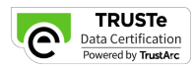





Our commitments and brand reputation
CERTIFICATION
Top 1% globally
3rd ranked cyber secure
SUSTAINABILITY COMMITMENTS
Virtusa’s Net-Zero
targets validated by SBTi
Near-term (FY2030) and net-zero (FY2040) targets for scopes 1,2 and 3
A GREAT PLACE
TO WORK
Virtusa Earns 2023 Great Place To Work Certification
in 8 countries
India's Best Companies
To Work in 2025
Our brand is strong
Top 25 brand value ranking ($817M) Ranked 25^{th;}
AA+ Brand Strength rating
Tied for 14th
Ahead of EPAM and LTI Mindtree
Virtusa ranked
8th out of the Top 50
Consulting Firms of 2024
RANKING
Virtusa recognized as a CDP Climate A list organization in 2025
TOP EMPLOYER
Top Employer 2025.
15th consecutive year in the UK and 5th year in the UAE
RANKING
Achieved EcoVadis GOLD Ranking for sustainability
Top
10%
Industry percentile in overall Net Promoter Score
‹#›
© Virtusa Corporation. All Rights Reserved.

Slide 12
In summary, why Virtusa?
Founded in 1996 and privately held by EQT.
We engineer the experiences that matter to your customers right alongside you because we understand your business as well as you do.
Customer
first mindset
Tech
certified talent
Industry
experts
Partnership powered
Global
scale
90%
NPS scores that fall in the 90th percentile
8th out of the top 50 Consulting Firms of 2025
4.7 out of 5 stars
for Custom Software Development Services ratings on Gartner peer insights
16,000+
trained in AI-assisted engineering
7+
years of average talent experience
2,500+
certified infrastructure architects, solutions specialists, and business consultants
12,000+
Industry trained professionals
100+
banking and insurance customers
8 out of top 10
healthcare insurers, telecommunication
companies across the globe
30,000+
world-class professionals
79
locations
34
countries
5000+
partner certified engineers
100+
Alliance partners
50+
marketplace solutions

Slide 13

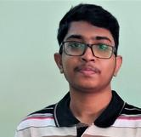

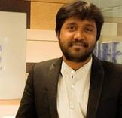
Who we are
Businesses today require transformational change at a scale and speed that defies traditional ways of working. We spark change through our Digital Transformation Studio that delivers deep digital engineering and industry expertise through client-specific and integrated agile scrum teams.
Testimonials
Parthasarathy S
Campus Intern (BE – CSE, RMK& RMD
Work@Virtusa
Company informational
Virtusa helps business move forward, faster by combining
deep industry expertise and frictionless technology delivery.
Group of Institutions, 2022 campus hire)
“ Knowledge gained from the learning phase
Virtusa’s core values
helped me contribute very well to my team during the Software development phase. And I even got appreciation from virtusa twice. The journey from an ECE student to a Software developer was just amazing. Thank you so much, Virtusa.”
Core values areanincredibly important component
of fostering a common, shared culture and building a strong people driven platform for growth.
We believe core values are the essence of
who we are and who we should aspire to be.
Virtusa’s PIRL values
Passion
To inspire our global teams to
deliver extraordinary results
Innovation
Apply intellectual curiosity to reimagine better business outcomes for our clients
Arumugam Pillai Chidambaram
AssociateArchitect- Technology
“ Having joined Virtusa in 2010
as a campus fresher, in my experience, I would say there is a lot to learn here compared to its counterparts. I have seen the company grow manifold, and if you showcase talent, there are no limits to your growth - ‘Where I budded as an apprentice and now blooming as an architect.’ I am grateful to the company for giving me a challenging work environment that has contributed immensely to my personal and professional growth. I am proud to be a Virtusan.”
Respect
Protect our environment, honor our diversity and treat everyone with dignity
Leadership
Take personal responsibility when things go awry and always ascribe success to the team

Slide 14

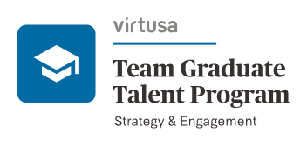



Campus placement insights
How to get hired?
Campus placement drive
Corporate policies we uphold
Public holidays – Team members are entitled to 11 holidays in a year per calendar specified for their respective work location
Smoke-free workplace – Virtusa does not promote
smoking in the workplace
Medical insurance - The company provides a basic
group medical insurance plan for all permanent team
members and dependents
Gratuity scheme - Team members who have completed
more than five (5) continuous years of service are eligible
for gratuity as per the provisions of the Payment of
Gratuity Act 1961
Marriage gift - All team members who get married during
their tenure in Virtusa will be presented with a gift
amount
of Rs. 10, 000 (subject to tax deduction)
Leave policy – The company offers various kinds of
leaves for the prosperous well being of co-workers,
some of which are:
Competitive hiring
Team Graduate Talent Program runs numerous hiring initiatives to make the process of talent identification fun and interactive. Students can register themselves as and when we launch and inform the placement cell:
We look forward to seeing you in our process and subsequently at work.
Open national hackathon Innovation contest exclusively for CoE students only Long-term internship offerings exclusively for CoE students only
To know more, follow our Instagram page @GTP_Virtusa
Earned leave - 21 days of earned leaves
will be credited in each calendar year
Sick leave - 6 days of sick leaves will
be credited in each calendar year
Maternity leave - 26 continuous calendar weeks
Performance management system - There are two
appraisal cycles in a year, namely Mid-Year Appraisal
(April to September) and Year-End Appraisal (April to
March) and each cycle consists of phases like objective
setting, assessment, normalization and review discussions
with the respective reporting managers
Rewards & recognition – We celebrate our team members’
small accomplishments as big wins with awards such as
the Stellar award, Eminent Leader award, Virtusa Dream
Team award, and so on, to name a few
Higher education – 2 esteemed universities partnered to provide best educational support to the employees.
IIT Madras & BITS Pilani offers exclusive MTech program for Virtusa employees

Slide 15
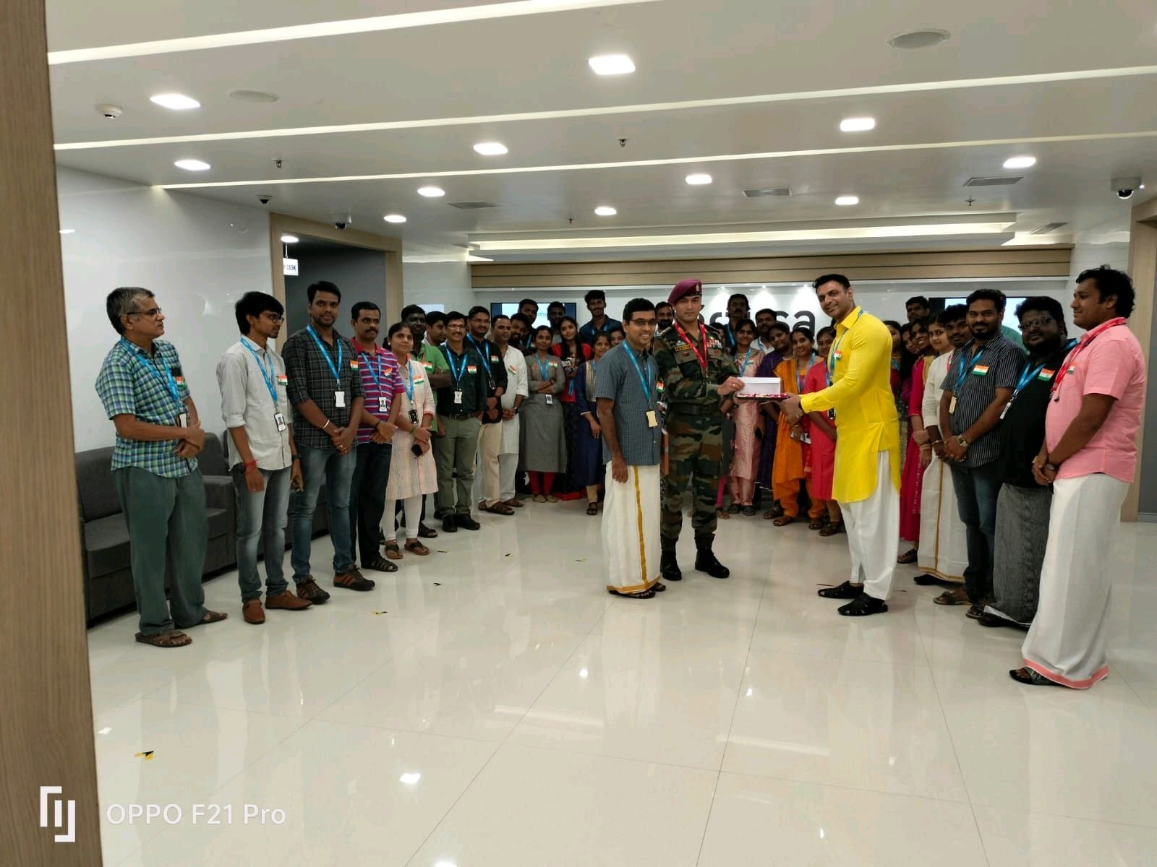
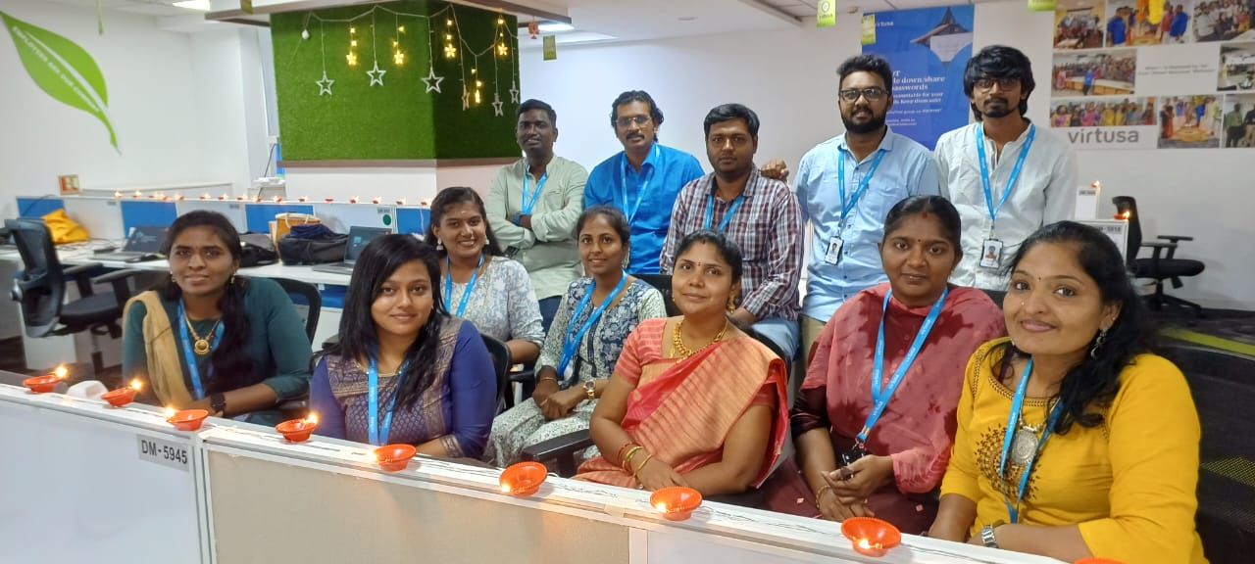
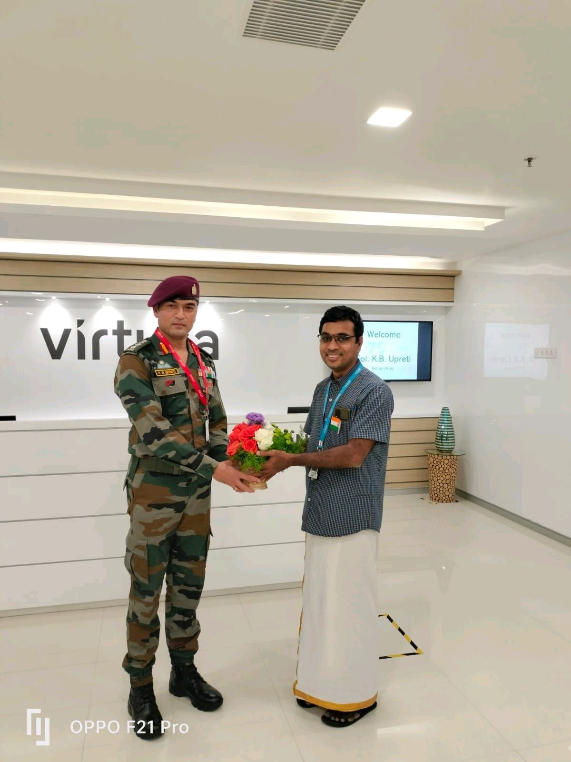
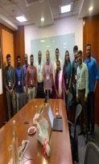
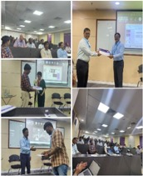
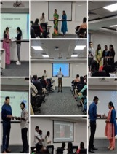
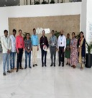
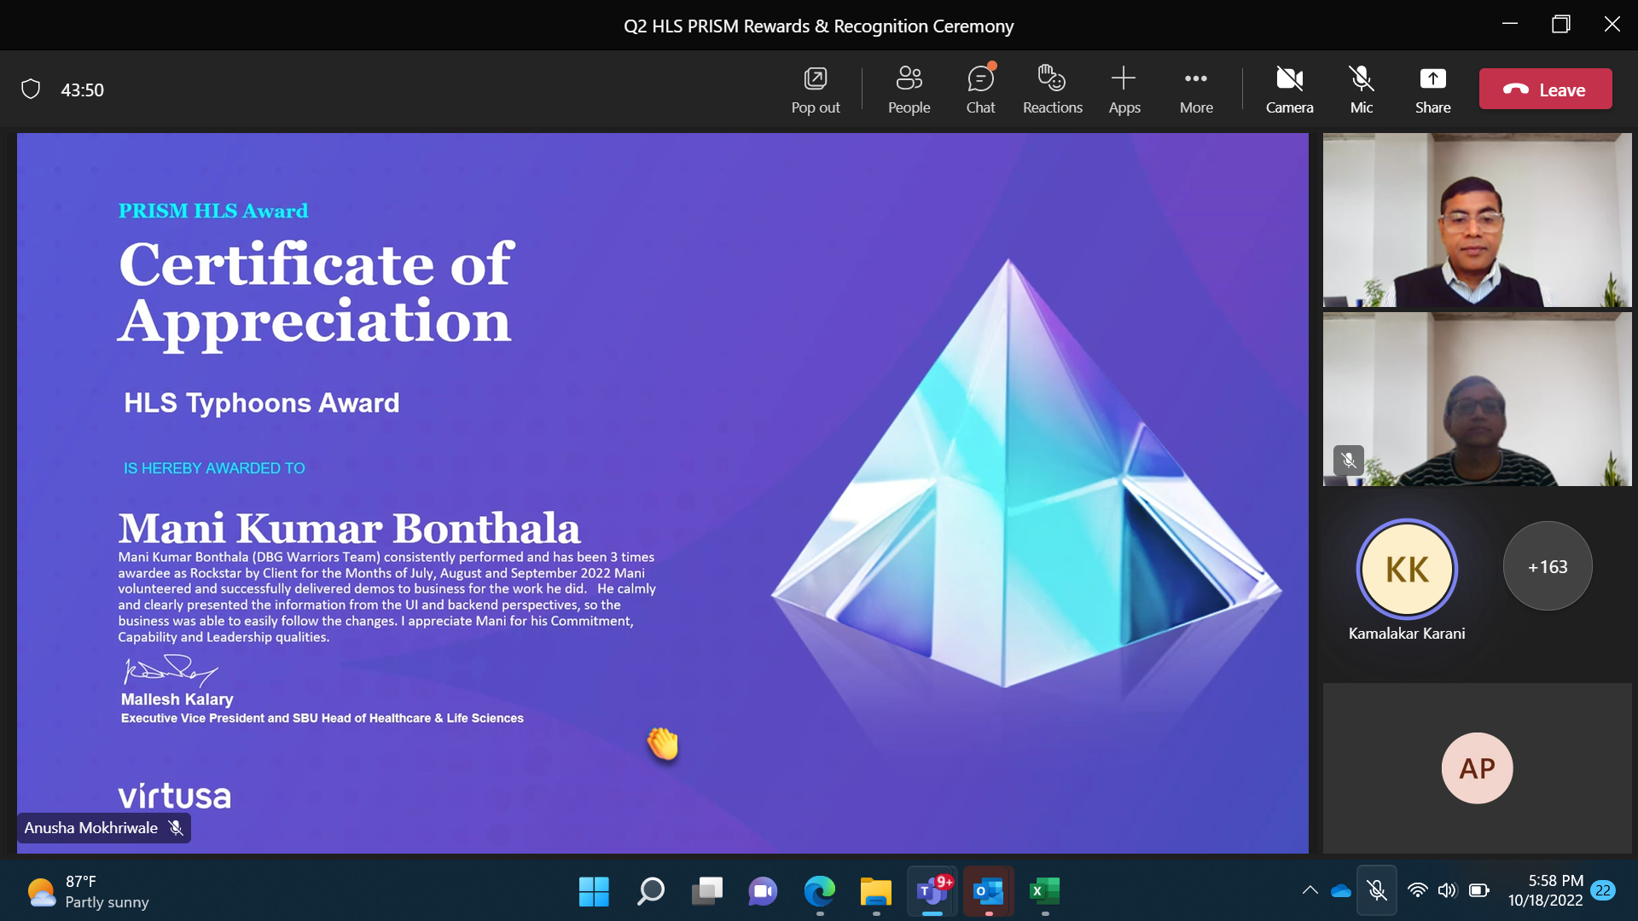
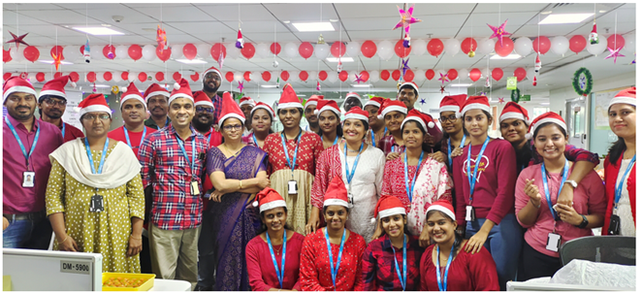
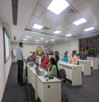
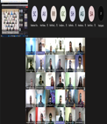
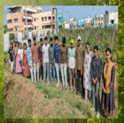
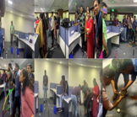
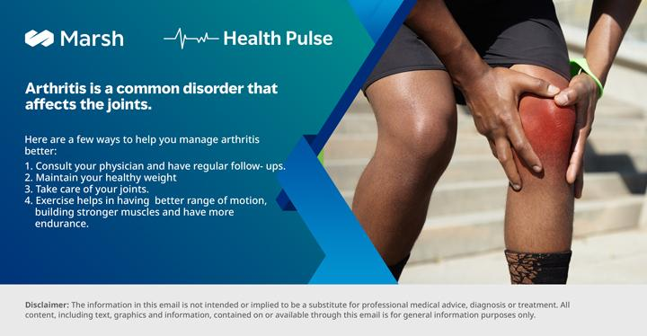
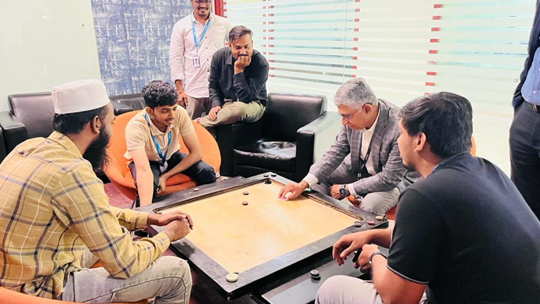
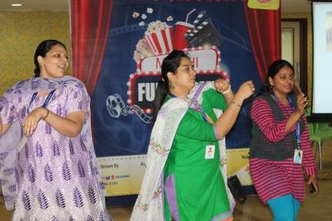
Talent Engagements

Slide 16
Eligibility & Offer Details
Criterion for eligibility:
65% aggregate across 10th, 12th and degree
Stream: BE, BTech- IT, CSE & Computer science related branches
No active backlogs
Offers:
2 type of offers
  Regular coders- can do basic to intermediate coding; 5LPA
  Power coders- can do intermediate to high level coding- gets higher package; 6.5LPA

Slide 17
Interview process
Stage 1- Initial assessment(MCQ + Coding)- 271 Minutes (251 Minutes + 20 Minutes Break)+
Speech X (Speaking + Listening)- 45 mins
To be conducted in campus – invigilation by college
Includes topics-
Analytical Ability and Problem Solving | Technical Skills
Numerical Ability | Data Structures
Grammar and Vocabulary | OOPS Concept
Reading Comprehension | Operating System General concepts
Writing Skills | MySQL - Basics , MySQL – Joins
Coding | ANSI SQL, SQL – Joins
Power coding | MySQL – Subqueries
 | Pseudo Code - Basic Programming
 | Pseudocode - recursion
Stage 2- Coding Event- 150 mins
3 coding questions to crack
To be conducted in campus – invigilation by Virtusa
Stage 3- Technical & Communication Interview
Discussion with the technical panel in Virtusa office
Stage 4- HR Interview
Discussion with the HR panel

